Slide 1
Somatic Simu
Mutational signature simulator for benchmarking alignment-free
machine learning classification of genomic signatures

Slide 2
Introduction
Mutation Signatures: overview
Somatic mutations in cancer genomes can have an exogenous and endogenous origin
Characteristic mutations lead to a signature
Signatures have unique identifying features that differ relative to other signatures
Figure 1. Catalogue of Mutations in Cancer Genomes
Source: https://software.broadinstitute.org/cancer/cga/msp

Slide 3
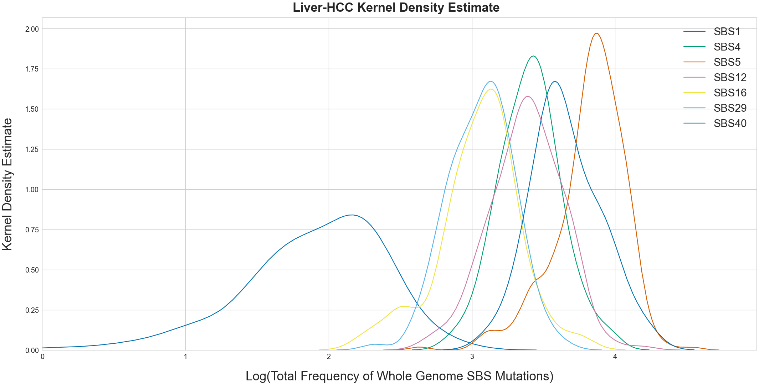
Introduction
Features of mutation signatures
Multiple mutational processes lead to superimposed signatures
Mathematical models estimate which mutations are attributed to which signature
Potential for classification
Figure 2. Kernel density estimate of total number of mutations
attributed to SBS mutational signatures operative in Liver-HCC

Slide 4
Literature
Single Base substitution classification (SBS-96)
C>G
A
C>T
A
96
SBS
Types
C
C>A
C
G
T>A
G
T
T>C
T
T>G

Slide 5
Research Proposal
Research proposal
Genomic signatures have proven to be useful as methods for taxonomic classification
Alignment-free machine learning approaches can classify at the species level
Source: https://www.nature.com/articles/s41598-018-38157-3
Source: https://bmcgenomics.biomedcentral.com/articles/10.1186/s12864-019-5571-y
To what degree of accuracy and sensitivity can alignment-free machine learning approaches classify cancer whole genomic signatures?

Slide 6
Methods
Somatic simu data pipeline
Mutation probabilities calculated from the PCAWG Signature Dataset:
2780 whole cancer genomes
37 cancer types
4 Signature types: SBS-96, DBS-78, Single Base Insertion and Deletion-24

Slide 7
Somatic SiMu
Use Case
Generated simulated sequences as fasta files with biologically representative frequencies of imposed SBS, DBS, and single base indels as a proof of concept for directed evolution simulation at the genomic signature level
Artificial upsampling of minority classes to obtain a more balanced data distribution recommended for supervised machine learning
Benchmark the alignment-free machine learning approach for sensitivity between different cancer types
Benchmark alignment-free machine learning approaches for accuracy across successive iterations of mutation signature simulation on the same sequence

Slide 8
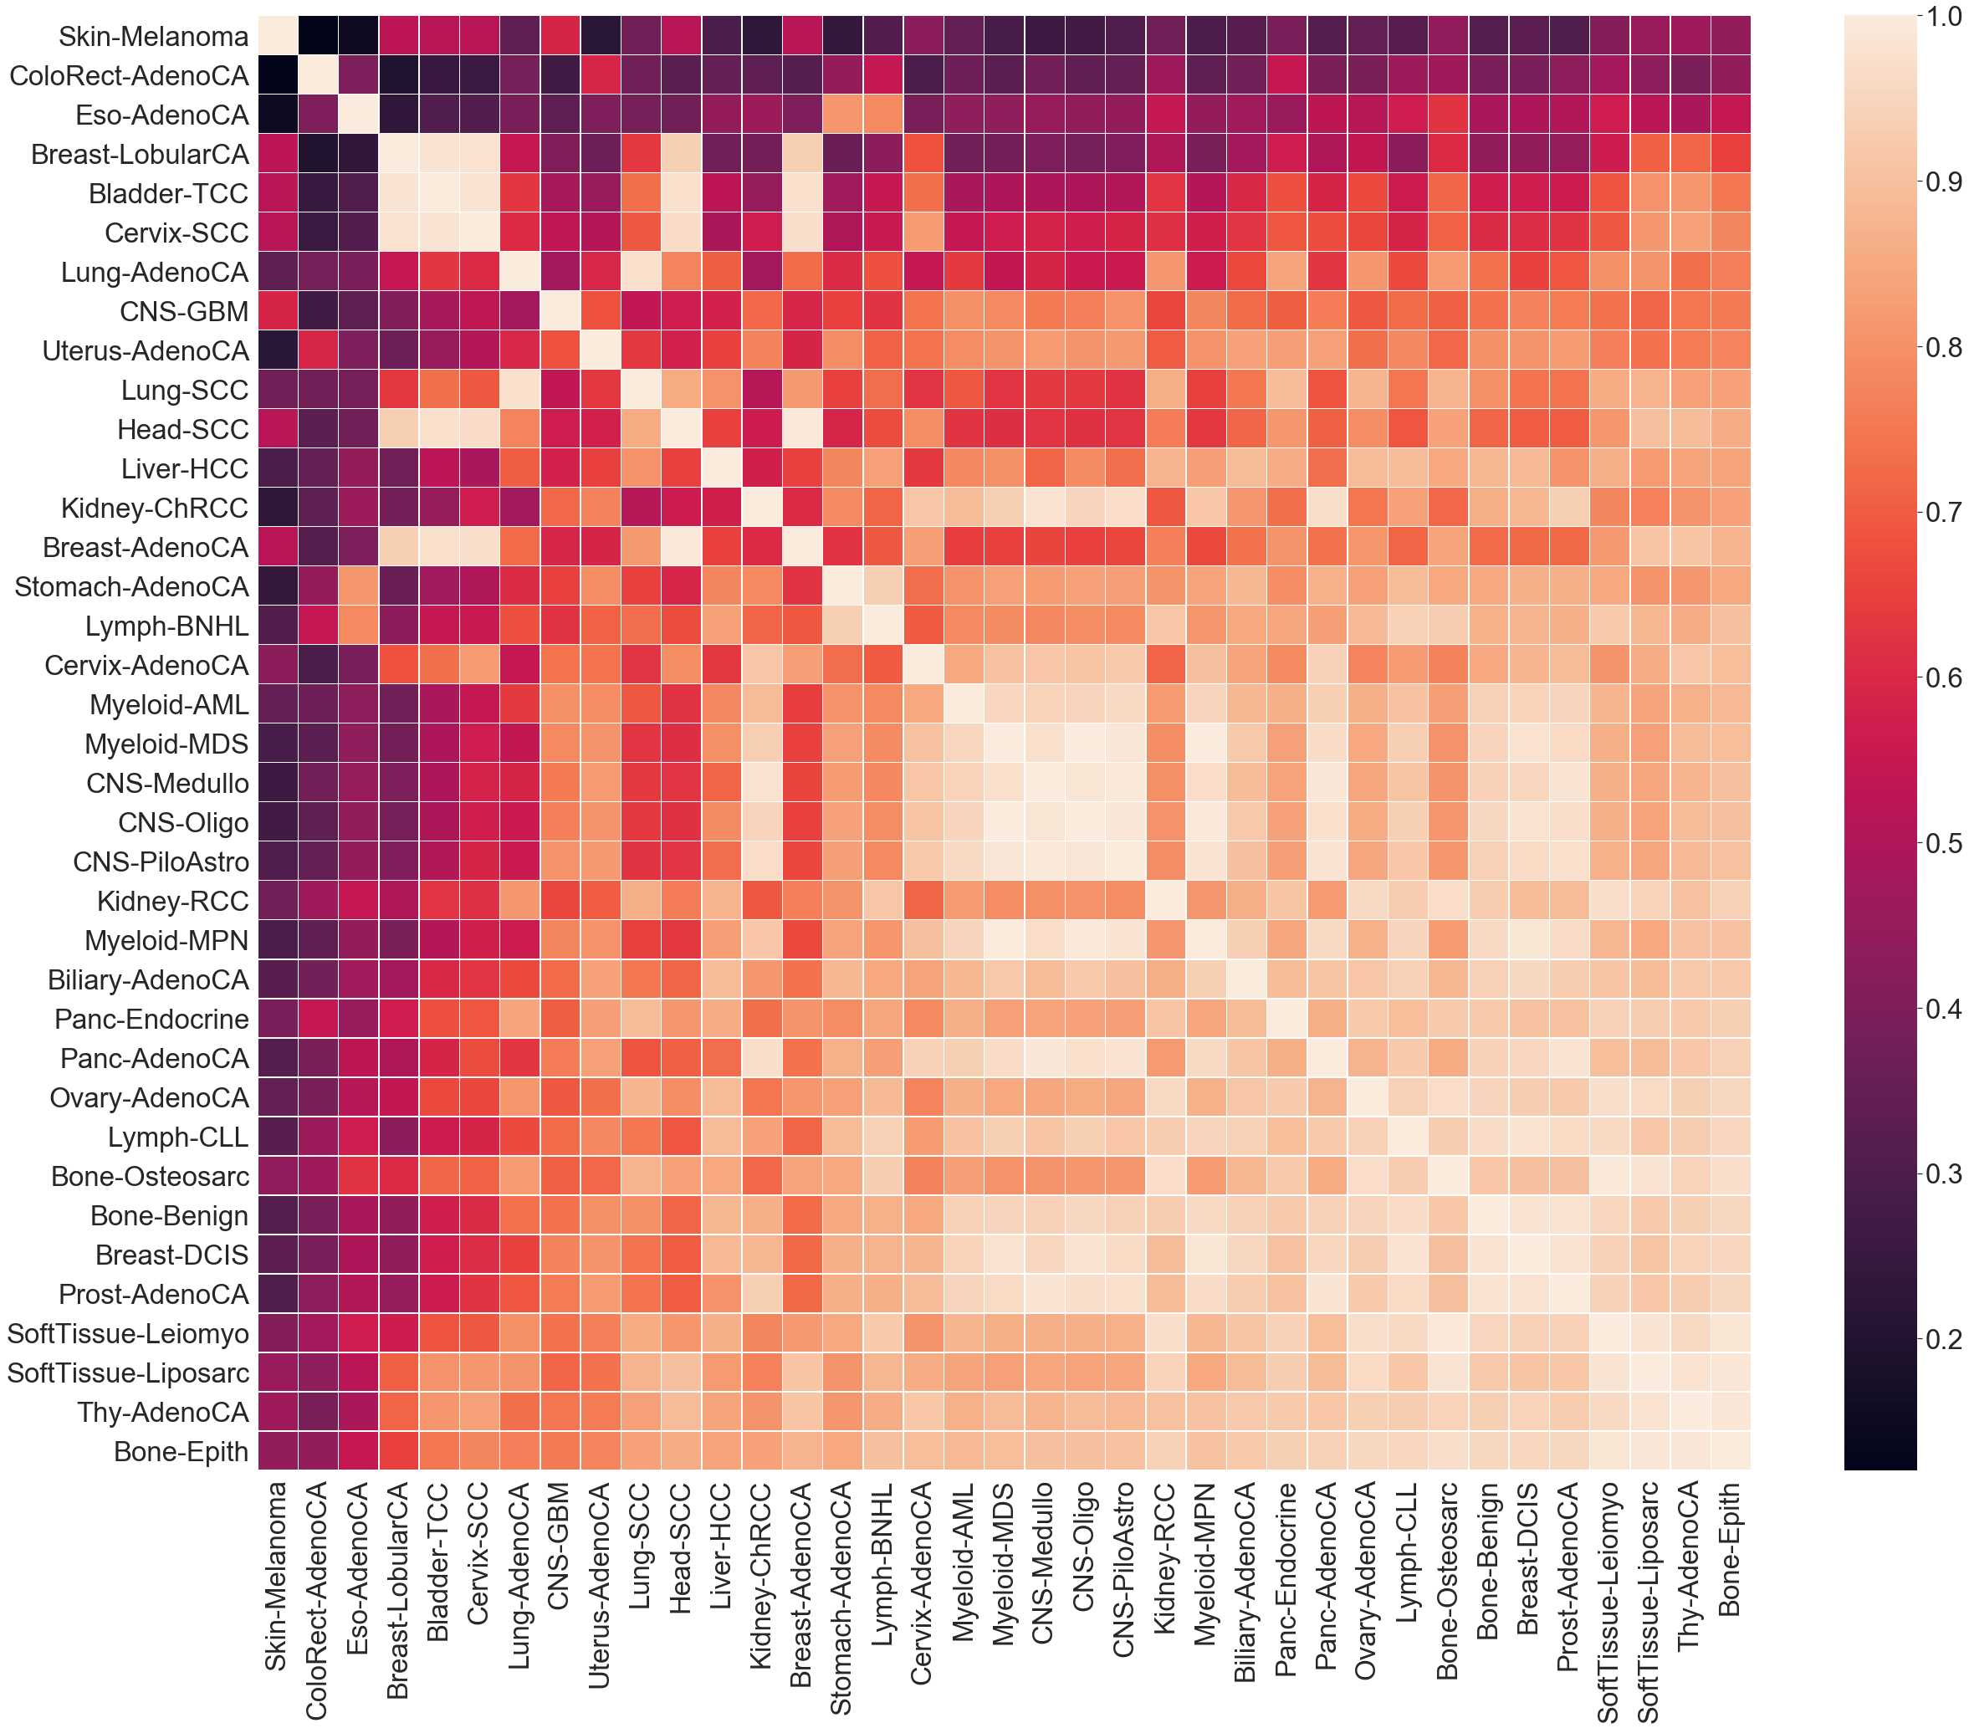
Methods
Cosine Similarity of SBS Mutation Probabilities
Cosine similarity is metric used to compare the similarity of a multidimensional metric
Higher score indicates higher similarity between cancer types and more similar evolutionary trajectories

Slide 9
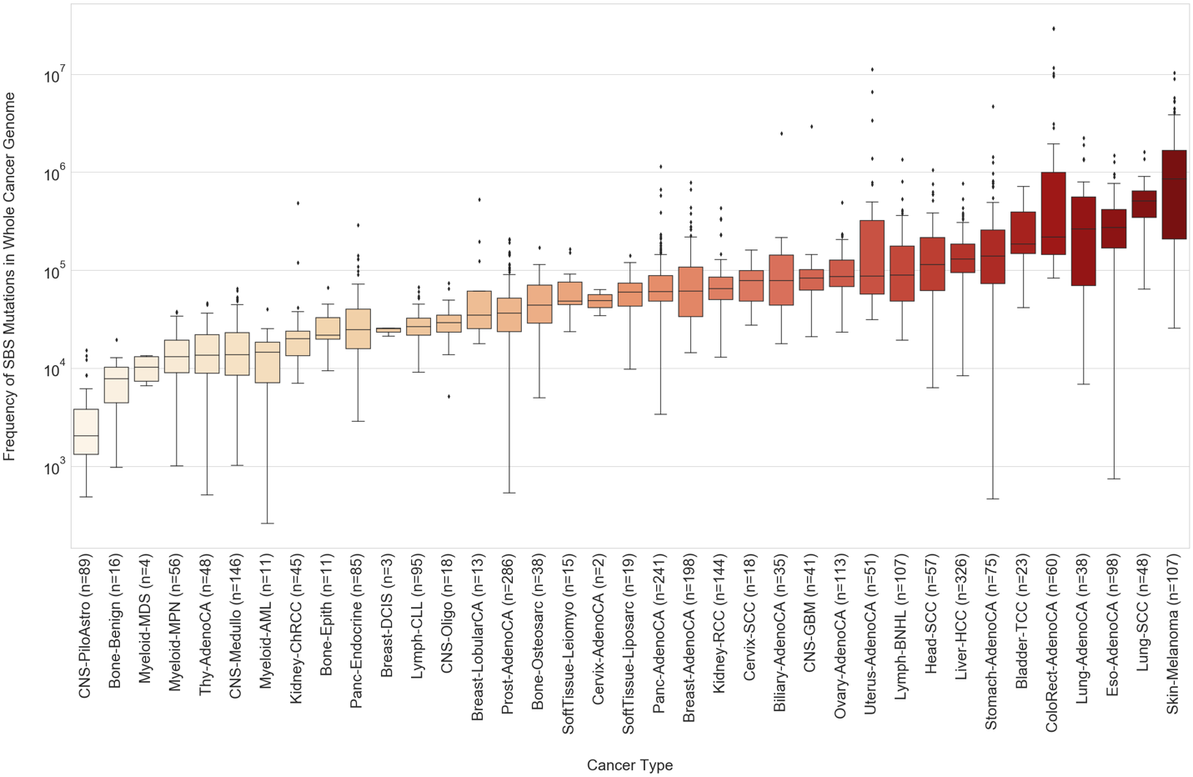
Methods
SBS Mutation Burden in whole genome

Slide 10
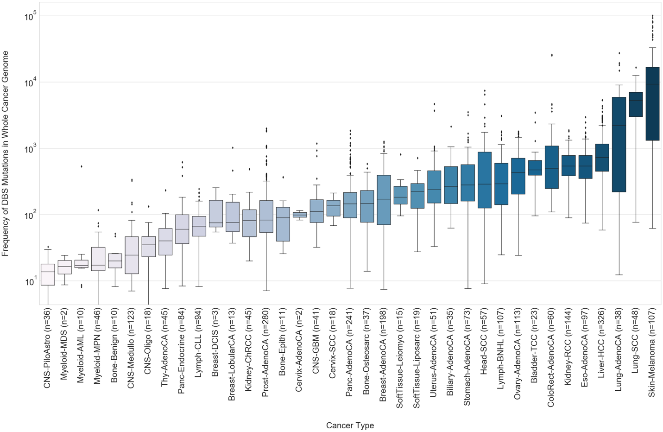
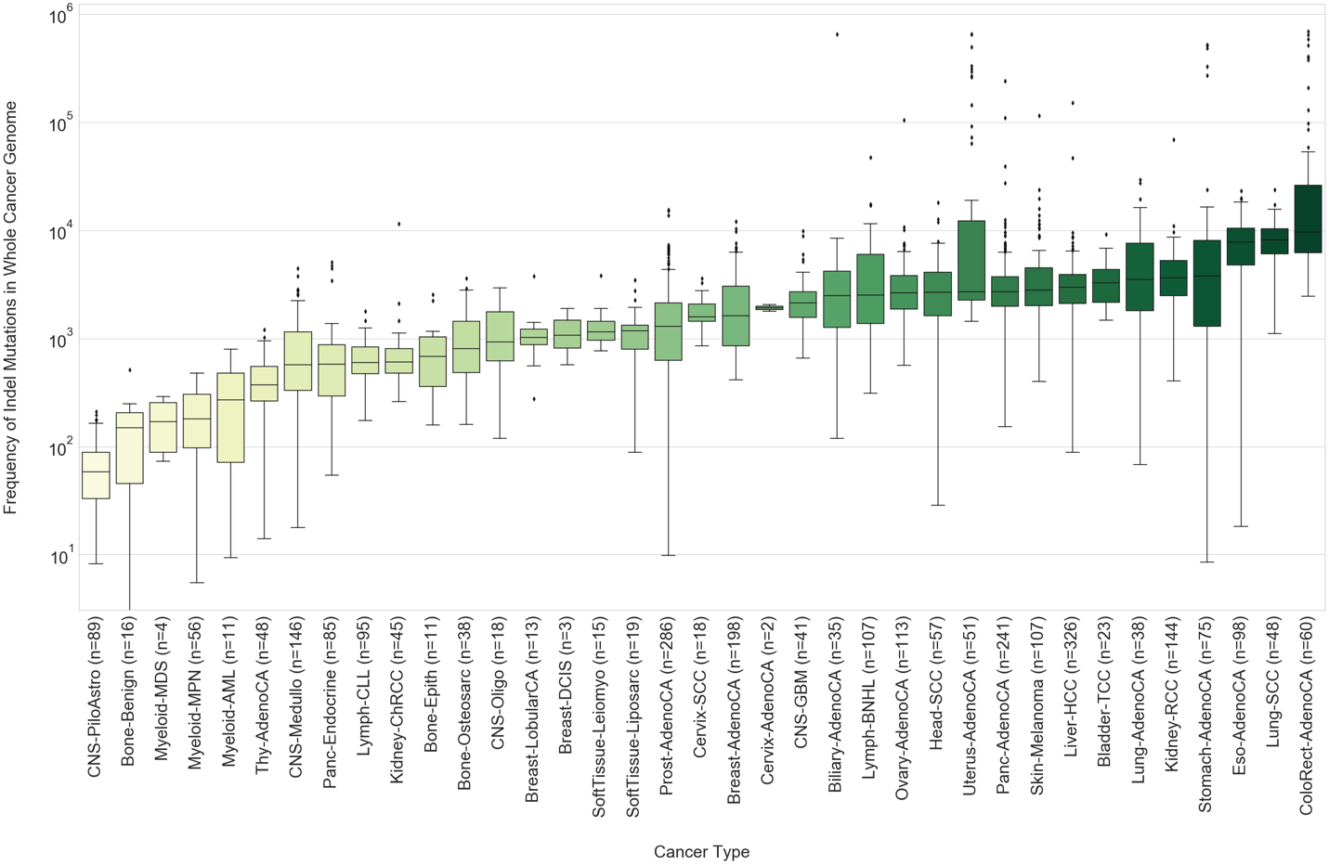
Methods
DBS and Indel Mutation Burden in whole genome

Slide 11
Methods
Parallel Directed evolution simulation
Iteration 1
Iteration 2
Iteration 3
Cancer
Type Signatures

Slide 12
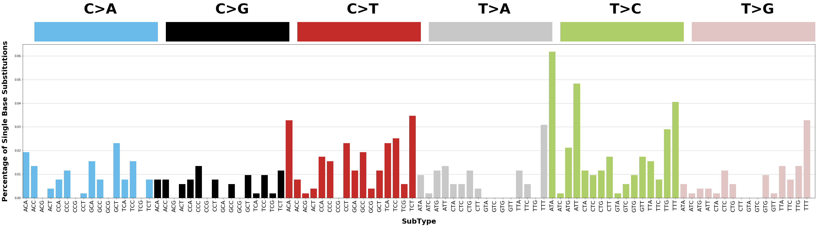
Results
Proof of concept
96-type SBS Mutation Catalogue of simulated mutations bootstrapped 100 times on Chromosome 22
Source: https://cancer.sanger.ac.uk/cosmic/signatures/

Slide 13
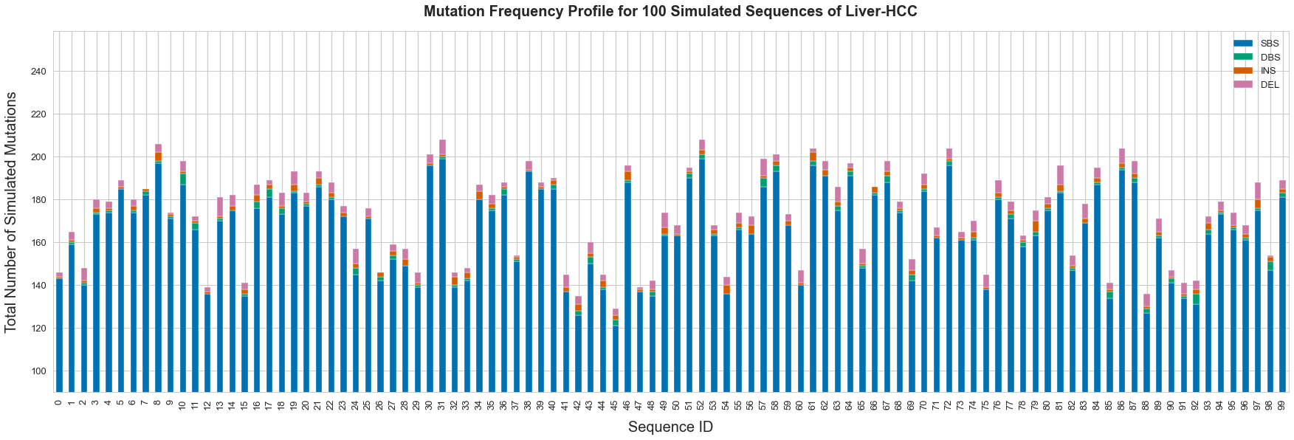
Results
Proof of concept
Counts of simulated SBS, DBS and indel mutations bootstrapped 100 times on Chromosome 22

Slide 14
Results
Machine learning with digital signal processing

